Slide 1
IUTCMS(Course Mangement System)

Slide 2

Team Members
Meet The Team
Nafiz Zaman
180042115
Adiba Hassan
180042111
Al Muhtasim Srijon
180042107

Slide 3

Key Features
Managing Courses easily and efficiently
1
2
Getting all information about courses at a glance
3
Assigning Faculties based on availability and calculating loads both teacher-wise and semester-wise

Slide 4
Miscellaneous Feature
Easy to use
PDF Generation & Smart Suggestions
Current courses are managed through trivial processes, our system will make it efficient
The system will generate pdf documents of different types of reports and also show smart suggestions based on input

Slide 5

Phases
1
Adding course from main Syllabus and adding teachers from main database
Offering Courses and Load Calculations
2
3
Assigning Teachers and Load Distribution

Slide 6
Timeline of Project
Week 1-2
Week 5-8
Week 12-14
Analyzing the problem and brainstorming
Phase1 work
Frontend
&
Backend
Phase 3 Work
&
PDF generation
Week 3-4
Week 9-12
Wireframing, UI designing and prototyping
Phase 2 Work
Frontend
&
Backend

Slide 7

Target Audience
People from administration, Secretary
of a department, etc.

Slide 8

Future Plans
Better Error Handling
1
2
Assigning and unassigning load individually
3
Auto generating class routines

Slide 9
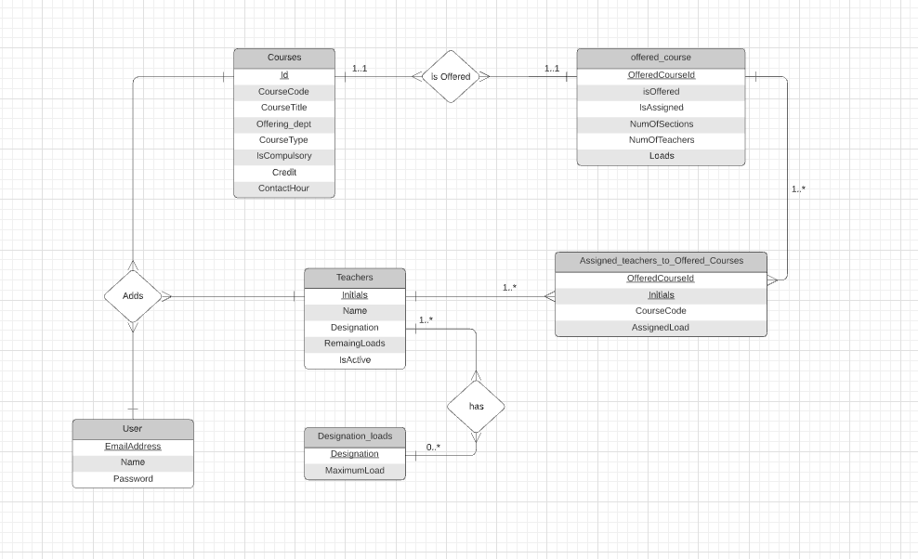

Slide 10


Technology to be Used
Back-End

Slide 11



Technology to be Used
Front-End

Slide 12

Technology to be Used
Database

Slide 13

Technology to be Used
Wireframing & UI

Slide 14
Thanks!
Does anyone have any questions?

